Slide 1



HEART FAILURE ANALYSIS
PROJECT MENTOR: GROUP MEMBER:
PROF. ARNAB CHAKRABORTY SAI SRIJA ACHUKOLU

Slide 2
content
Project Objective & Scope
Data Description
Methodology
Data Preprocessing
Models Used
Accuracy Comparison
Benefits of the project
Future Scope of Improvements

Slide 3
Project objective: Heart failure is a critical medical condition that affects numerous individuals worldwide. By leveraging the power of artificial intelligence (AI) and machine learning (ML), we can develop predictive models to identify the risk factors associated with heart failure. In this project, we will focus on the factors of age, sex, and previous diseases undergone by individuals to predict the likelihood of heart failure. PROJECT SCOPE: The scope of this project encompasses the development and evaluation of an AI and ML-based heart failure analysis system. The project will focus on analyzing the relationship between age, sex, previous diseases undergone, and the likelihood of heart failure.

Slide 4
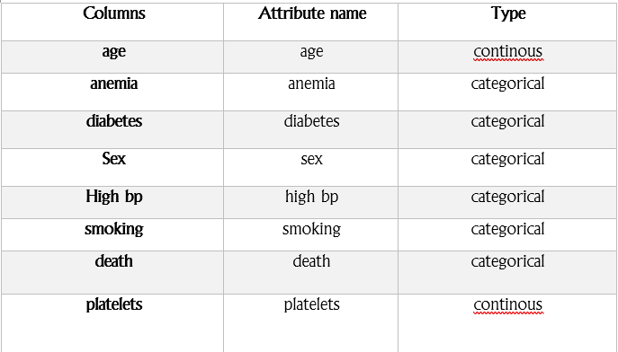
DATA DESCRIPTION The description of the data with type and description of each Attribute is given/shown in the table.

